Slide 1
Activity1 output page:
Web page of Bakery and Cake Shop

Slide 2
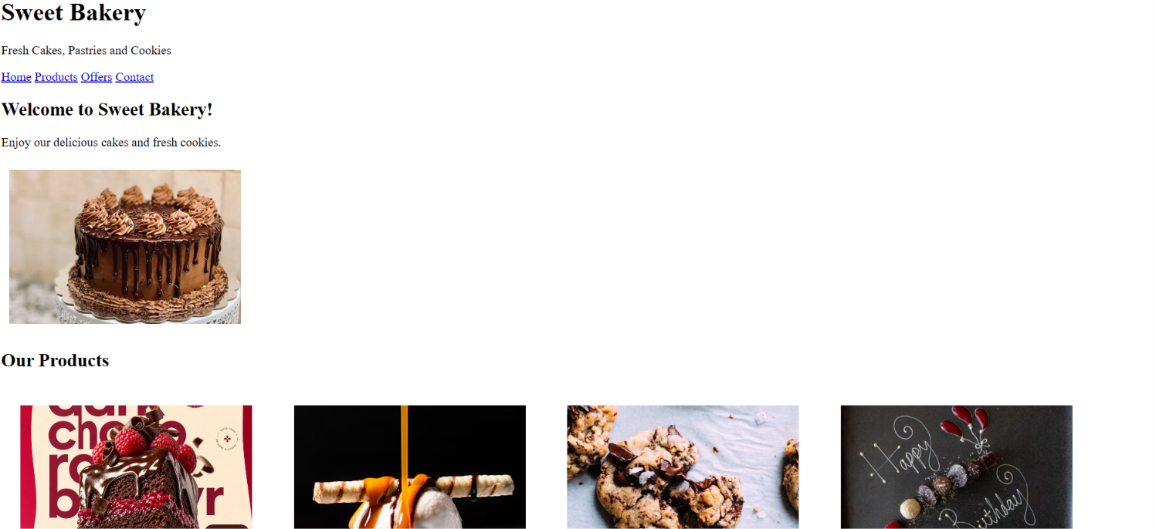

Slide 3
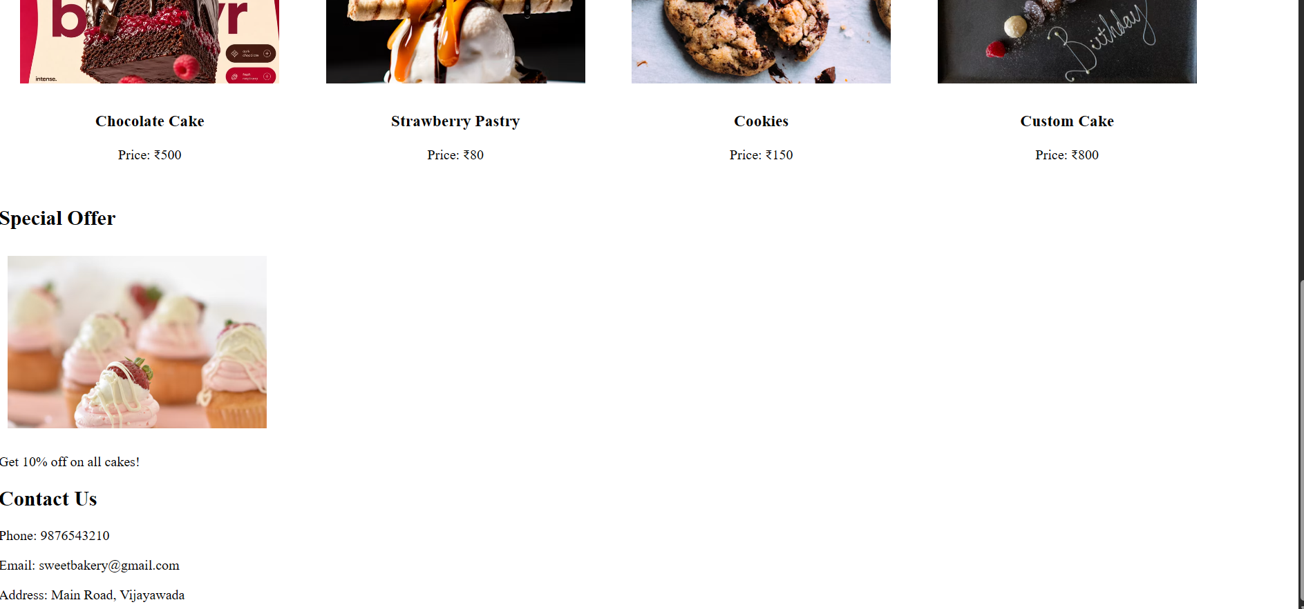

Slide 4
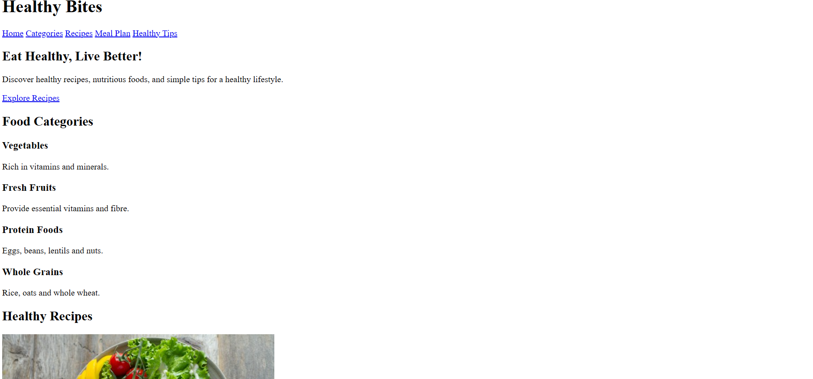
Activity2 Output page of Healthy Food and Nutrition

Slide 5
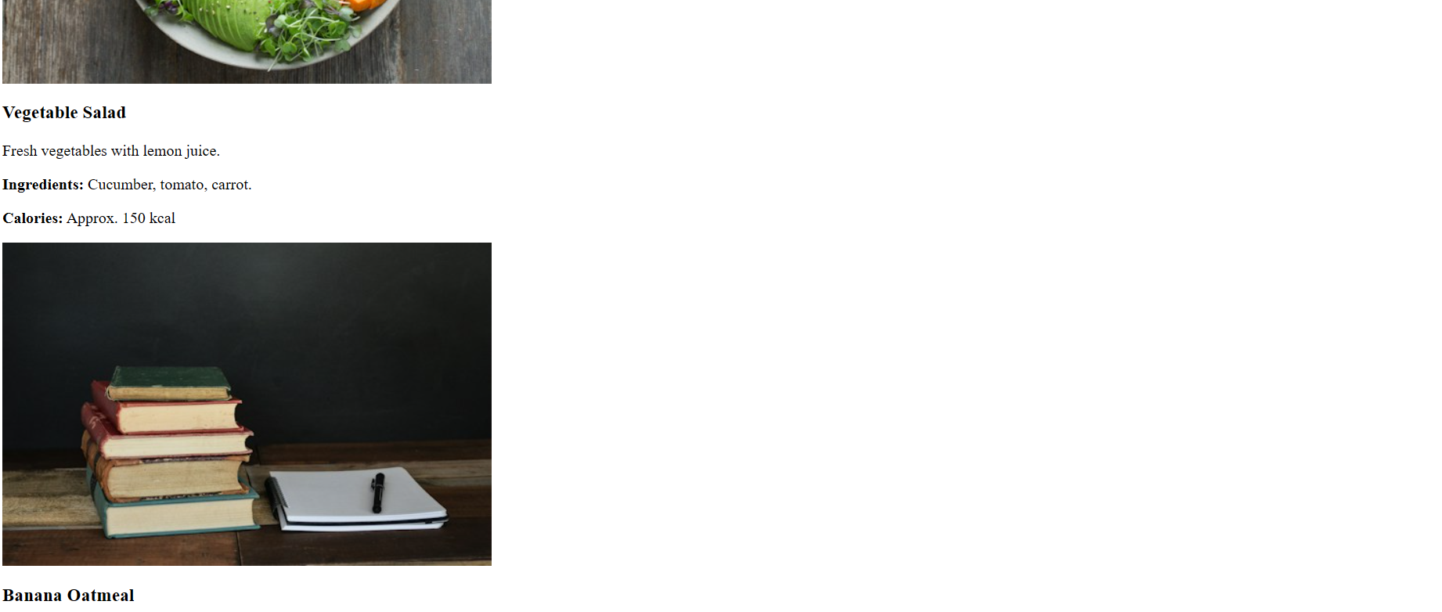

Slide 6
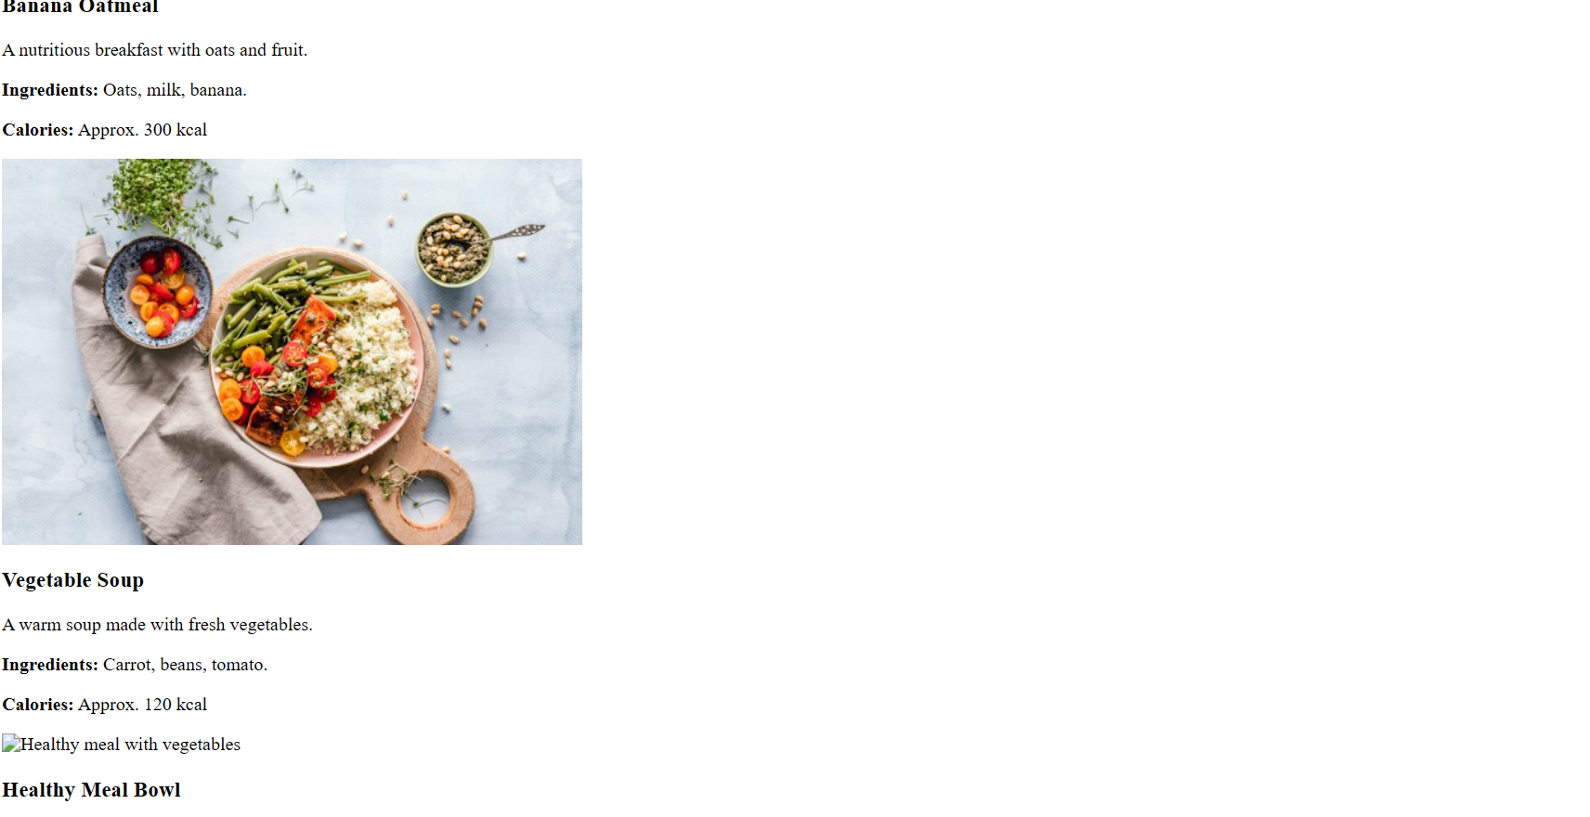

Slide 7
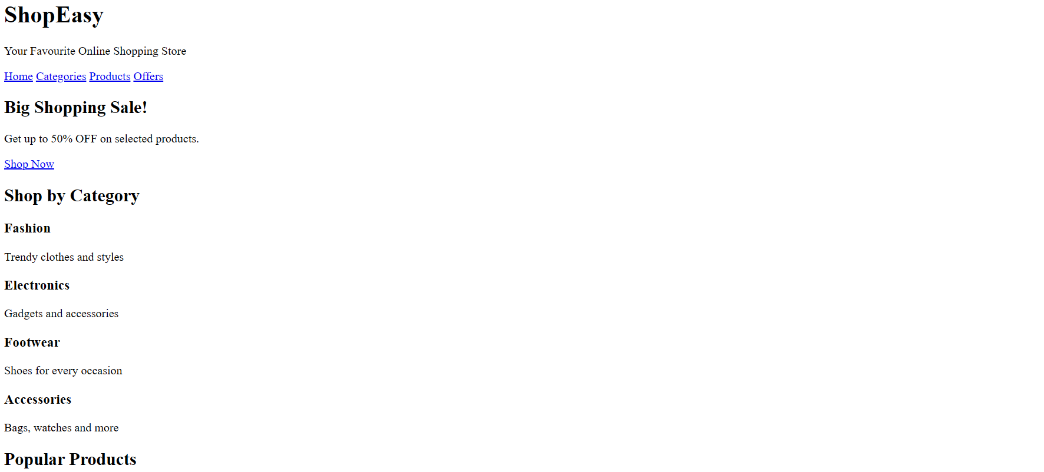
Activity3 outputpage of Online Shopping Website

Slide 8
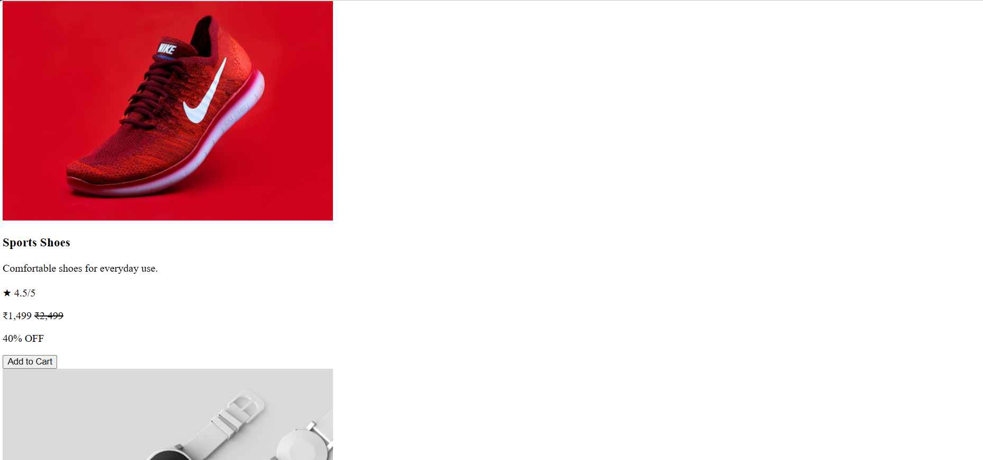

Slide 10
